Slide 1
Strategies for Culturally-Relevant Education about a Changing Ocean
Marilyn Sigman and Nora Deans

Slide 2
THEME: People, ocean, and climate
Weave – link scientists, educators, and coastal communities in Alaska
and nationwide with emphasis on ocean climate change.
Bridge western science and traditional knowledge about ocean climate
change to Alaska and the nation.

Slide 3
A Partnership
Division of
Ocean Sciences
Funded by
University Partners + Informal Education Partners + a Formal Education
Partner
Anchorage
School District
SFOS

Slide 4
Do you believe in climate change?
Do you believe it’s happening?
Do you believe that human activities are causing climate change?
Do you believe that most scientists agree that it’s happening?

Slide 5
National Poll Results
October, 2009: 57% said there was solid evidence of warming (down from 77% in 2006 and 71% in 2008)
October, 2009: 36% said humans were the cause of climate change (down from 47% in 2006 and 2008)
December, 2009: 36% said that scientists were generally in agreement that the world was warming
(down from 56% in May, 2009)

Slide 6
Climate Change Beliefs “Six Americas”
The Alarmed (18%)
The Concerned (33%)
The Cautious (19%)
The Doubtful (11%)
The Dismissive (7%)

Slide 7
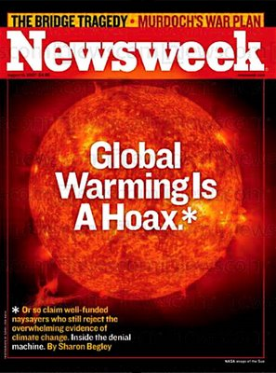
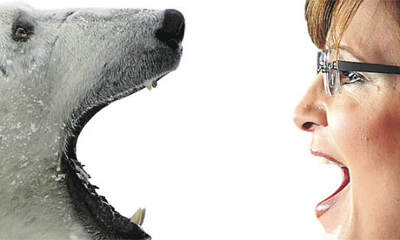
A Spectrum of Attitudes Exists in America
toward the Certainty of Science and the Scientific Method

Slide 8
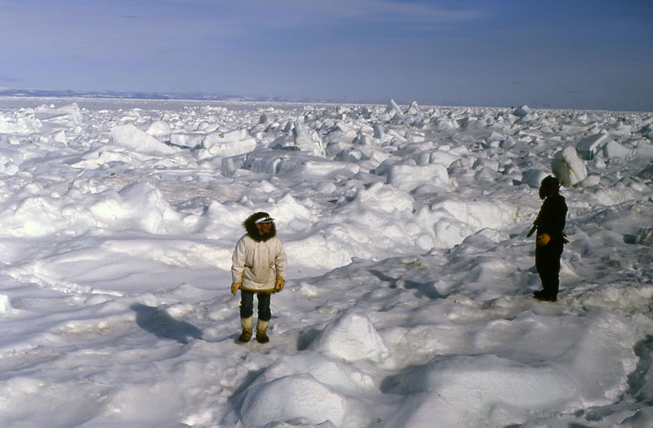
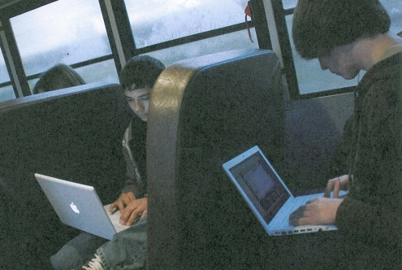
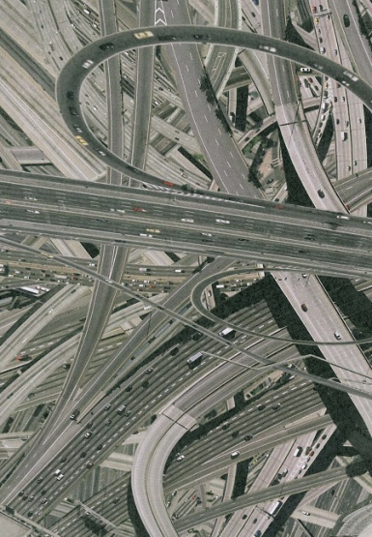
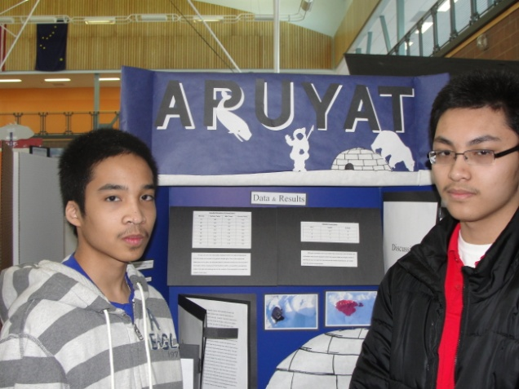
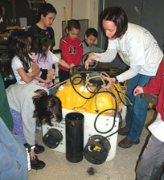
To Which Culture(s) should
Education Be Relevant
or Responsive?
Who Gets to Decide?

Slide 9
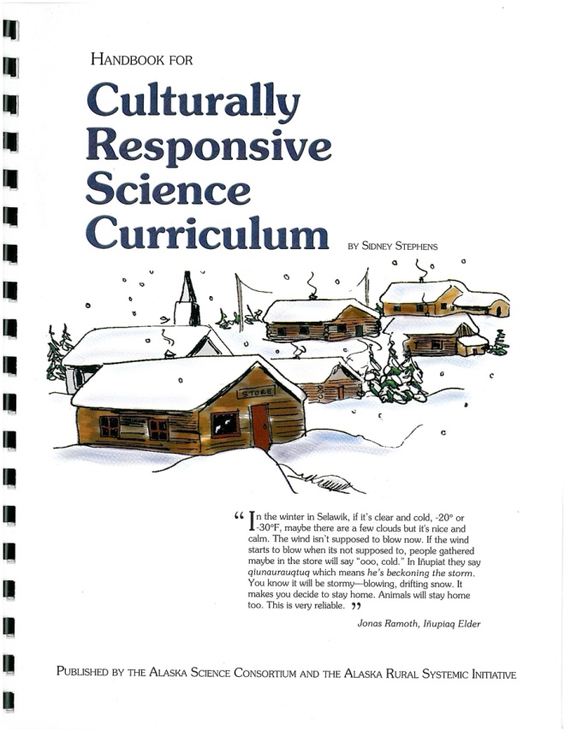
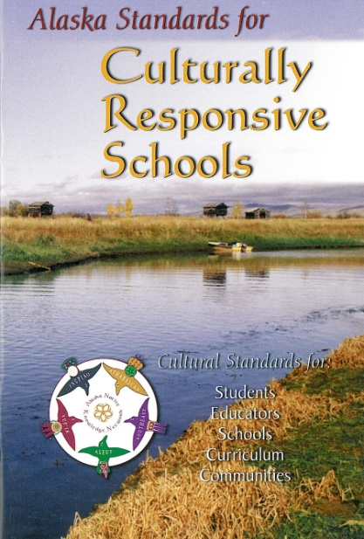
What It Looks like in Alaska
The Rural Systemic Initiative

Slide 10
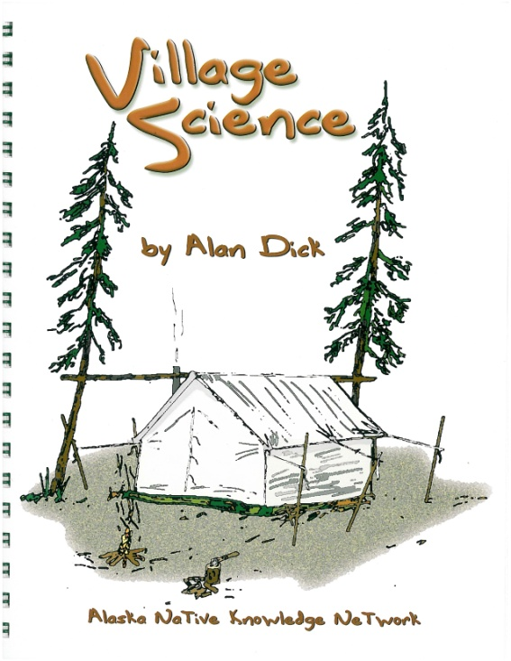
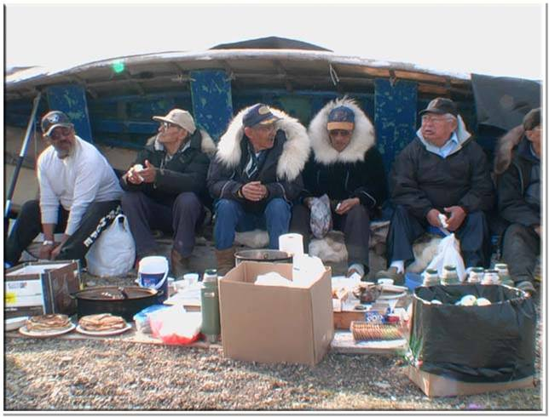
Focus
Alaska Native Cultures
Indigenous Cultures
“Alaska Bush” culture

Slide 11
Two Ways of Knowing
Western science
Place-based Knowledge
Traditional Knowledge or Indigenous Knowledge and Wisdom
Local Knowledge
Sense of Place (over a long-time period)
“Information, understanding and wisdom accumulated over time based on experience and often shared within a group or community”

Slide 12
Scientific Knowledge
Requires a rigorous method of inquiry and standards of validity that are consensus-based.
Provides a way to marshal evidence of environmental change and the rate of change.
Can provide conceptual understandings about complex and interrelated processes.
Cannot “prove “ anything or result in absolute truth or 100% certainty.

Slide 13
Place-based Knowledge
Is personal and often anecdotal or qualitative
Is valid is in its lived experience.
Has authority determined by the community that regards certain people as knowledgeable or wise.
Is often shared through story-telling.
For indigenous people, it is inter-generational and resides within a worldview that extends into spiritual and ethical realms.

Slide 15
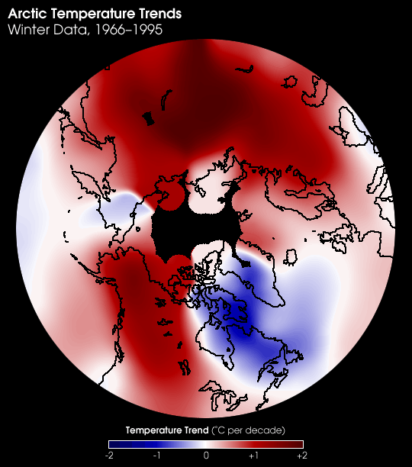
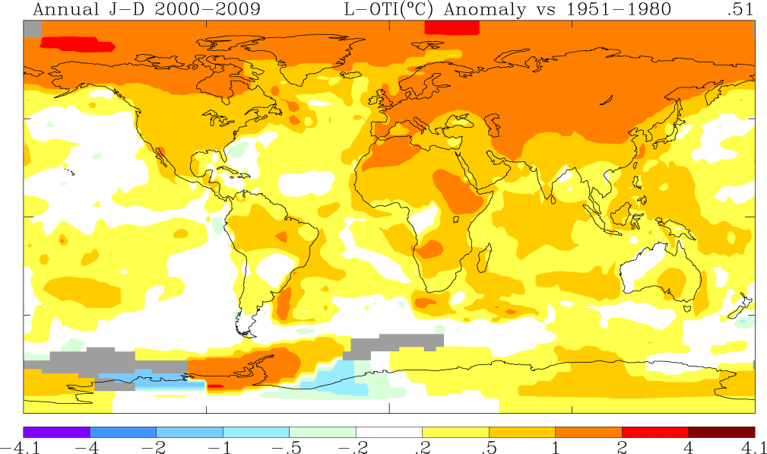
Climate Change in the Arctic: Warming Faster than the Rest of the Globe
2000 - 2009
1966-1995
-2º C.
+2º C.

Slide 16
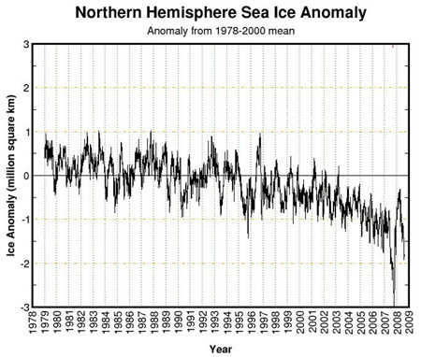
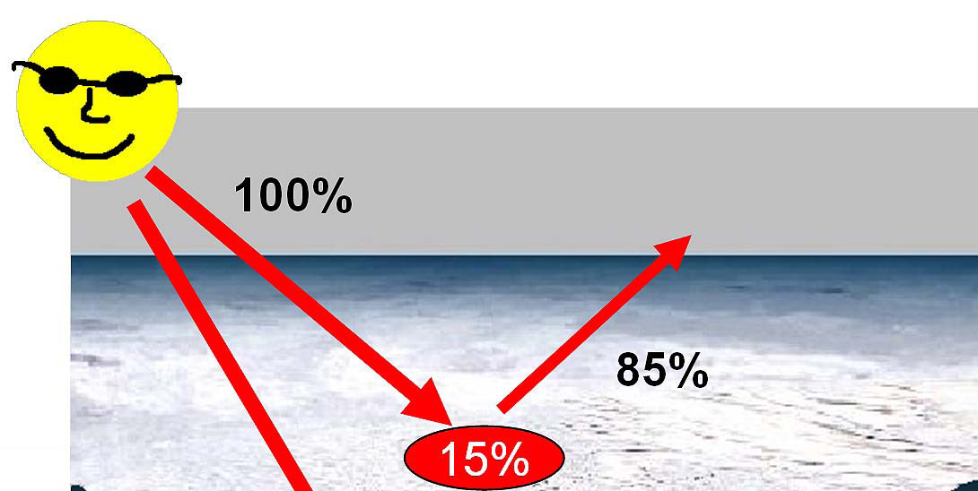
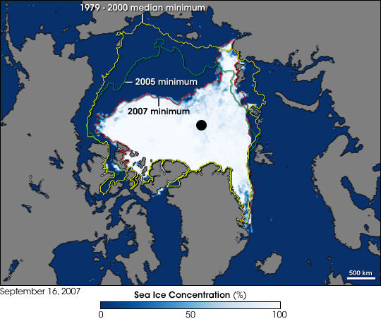
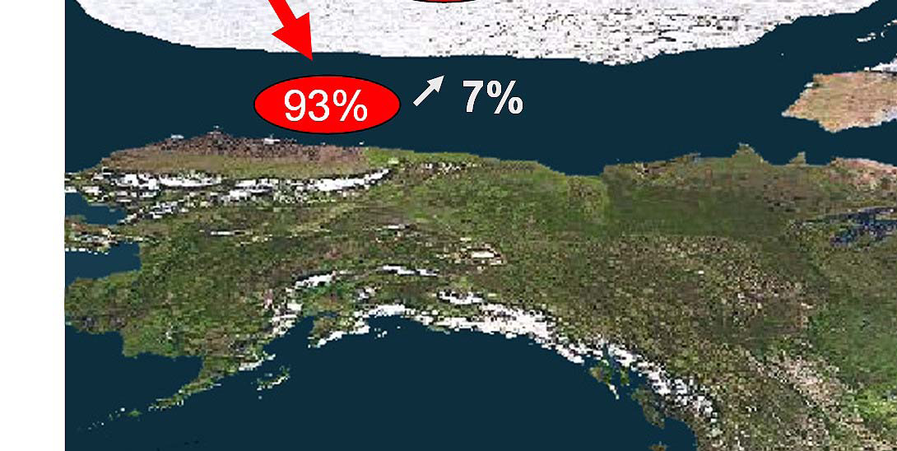
The Albedo Effect
Arctic Sea Ice –
Shrinking, Thinner,
and Younger
Notes:
Snow and ice regimes are sensitive to small temperature increases which can lead to subsequent amplification of the signal, are processes that could contribute to unusually large and rapid climate change in the Arctic.
Sea Ice acts as a refrigerator for the atmosphere but greenhouse gases trap the radiated heat.
Warmer atmosphere melts sea ice, heat absorbed by the ocean, then radiated back from the open water to the atmosphere in the fall. Atmosphere is thin, little evaporation. Affects land temperatures. +4 degs. C. above average in fall, 2008

Slide 17
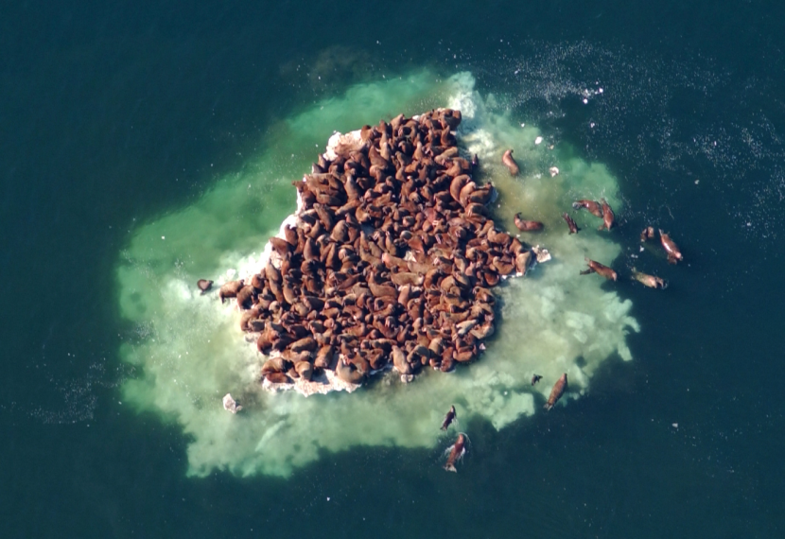
Shrinking Sea Ice Means Less Physical Habitat for Marine Mammals

Slide 18
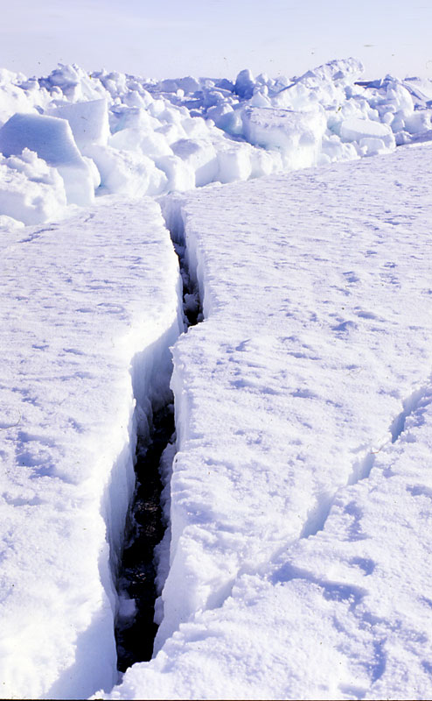
Changing Ice Conditions Makes Subsistence Hunting More Difficult or Dangerous

Slide 19
Climate Science & Native Knowledge is Complementary
Climate Science
Native Knowledge
Requires systems thinking
Consists of observations over a range of scales – study site to global
Has difficulty integrating knowledge across disciplines
Is holistic
Consists of local observations over long periods of times.
Integrates multiple variables (e.g, where to find marine mammals)

Slide 20
Alaska Strategies for Integrating Scientific and Place-based Knowledge
Integration of both into the curriculum, lesson plans, and teacher professional development
Sustained scientist-teacher partnerships
Science fairs with requirements for cultural or community relevance
Facilitation of scientist-community partnerships and learning cycles
Emphasis on storytelling

Slide 21
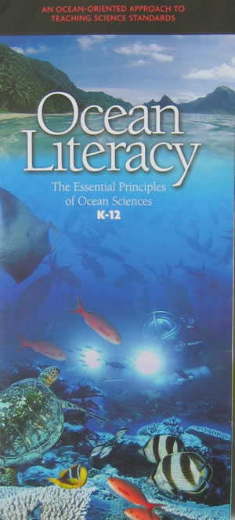
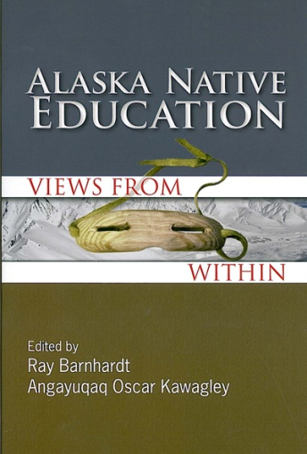
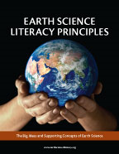
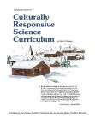
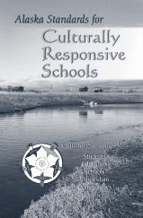
Integration into K-12 Curriculum
National Definitions of Literacy
Standards and Lesson Learned

Slide 22
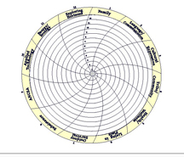
http://ankn.uaf.edu
Curriculum Resources

Slide 23
Ocean Science
Fairs:
Focus on ocean,
watersheds, and
climate change
A Manual with 200+ Project Ideas
“How-to” Videos on
http://ankn.uaf.edu/Curriculum/COSEE/index.html
On-site Support
Local winners compete in the State Science Fair

Slide 24
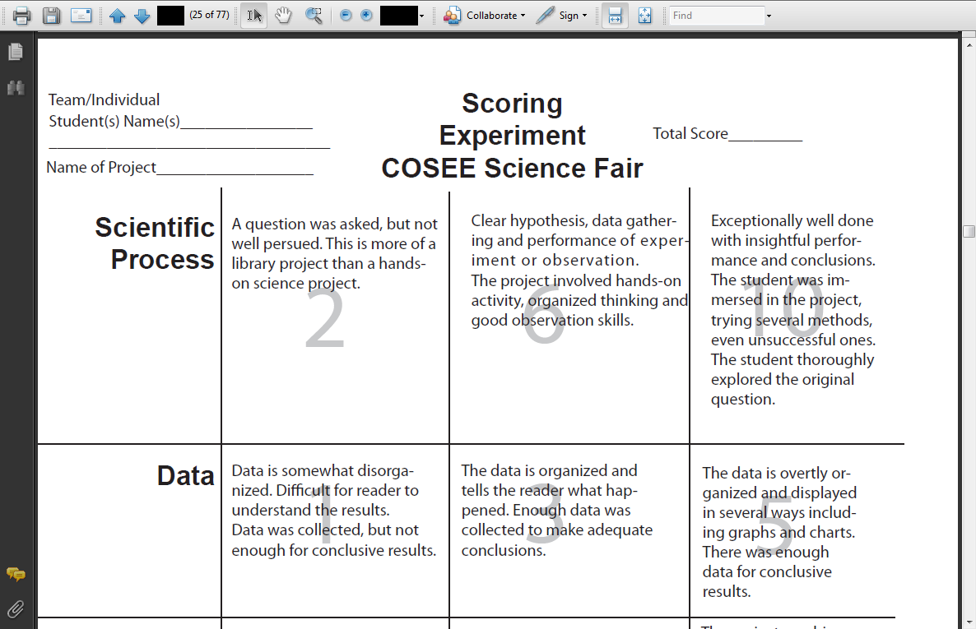
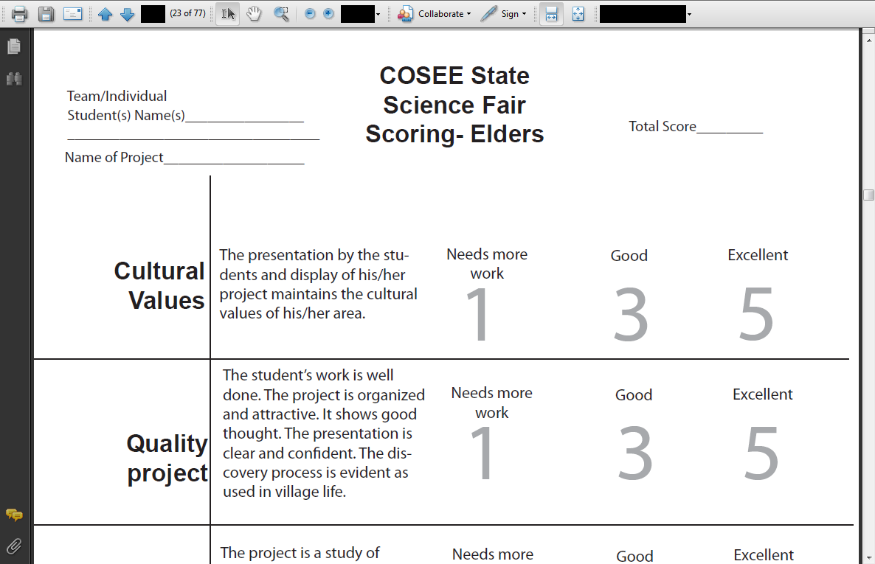
Two Types of Judges
Two Types of Scoring Rubrics

Slide 25
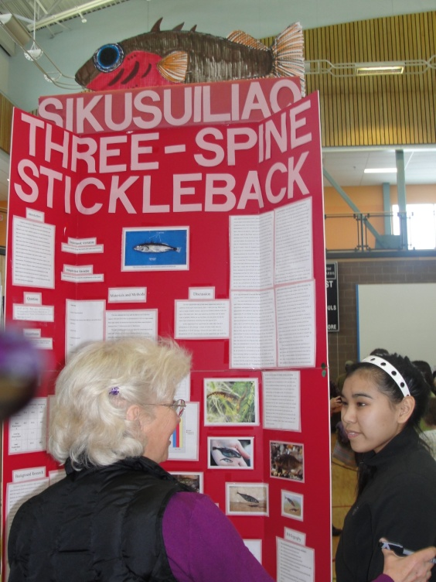
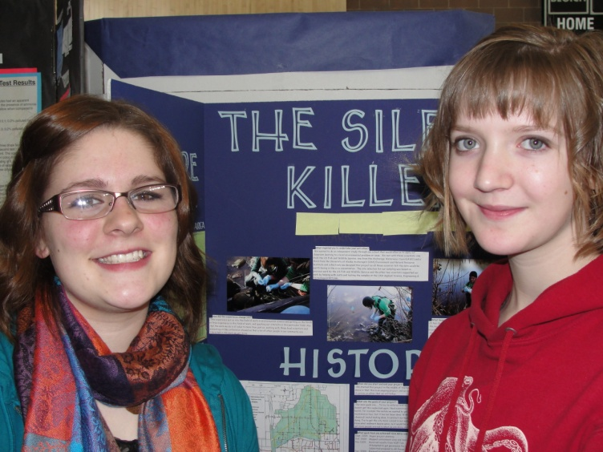
Ice Cellar Project
Anchorage Settling Pond Project

Slide 26
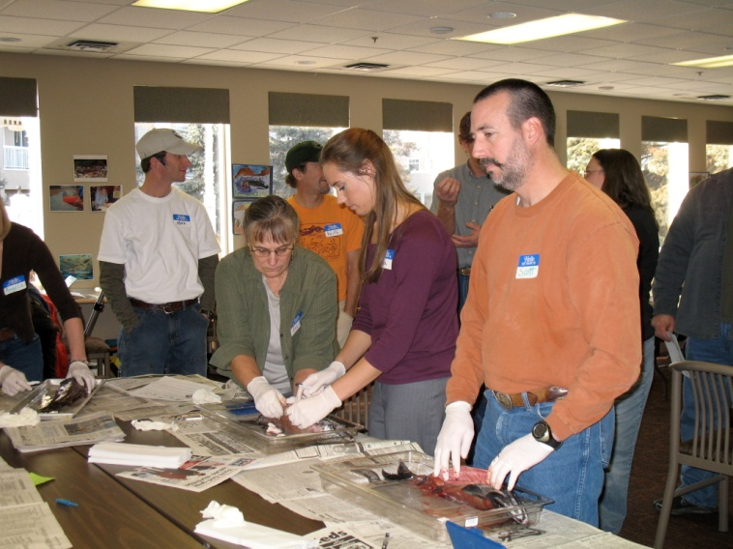
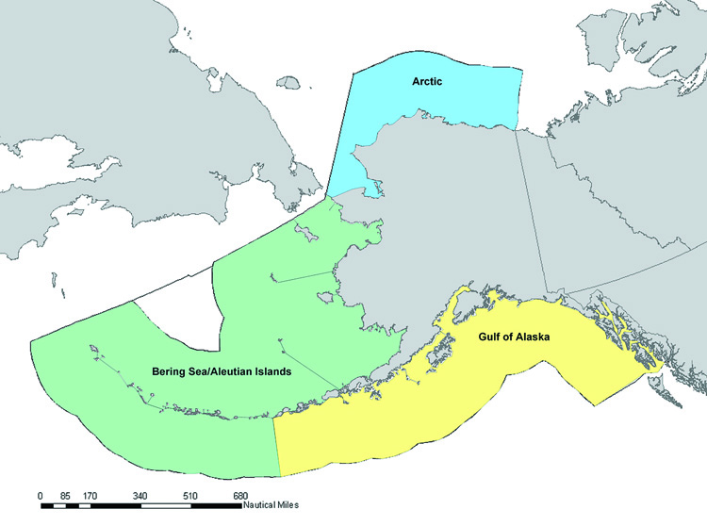
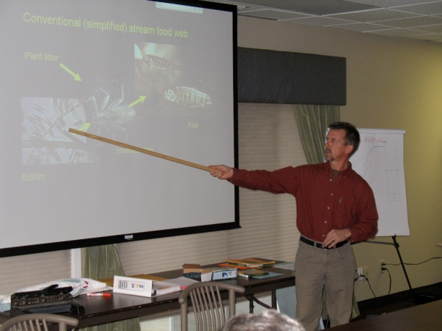
Professional Development
Curriculum
Development for
Large Marine Ecosystems
Salmon-in-the-Classroom
Learning Community
Scientist Involvement
and Partnerships

Slide 27
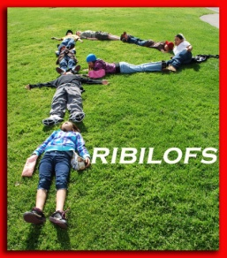
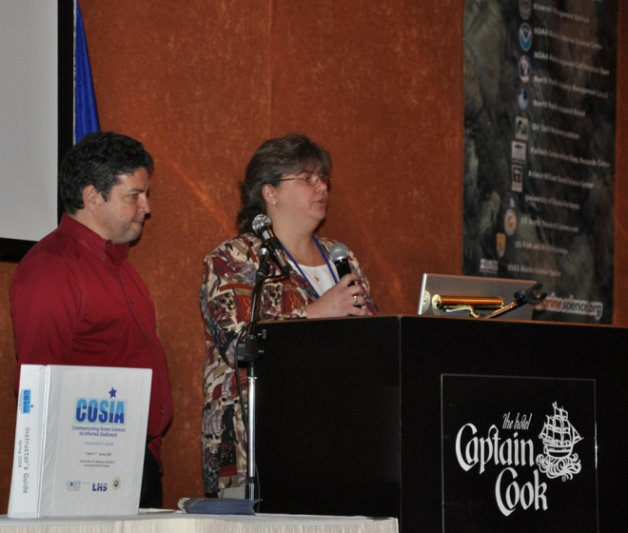
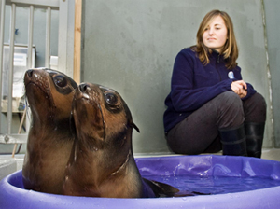
Sustained Teacher-Scientist Partnerships

Slide 28
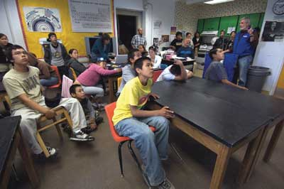
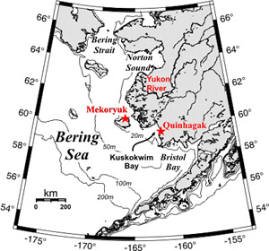
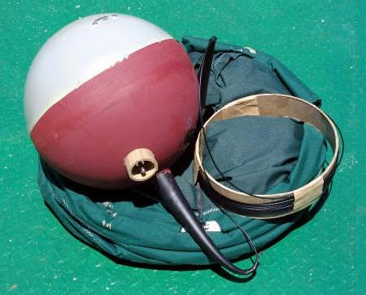
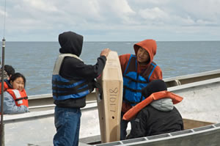
The Quinhagak Example
Quinagak
Students &
The Bering Sea
Drifter Study

Slide 29
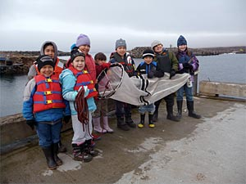
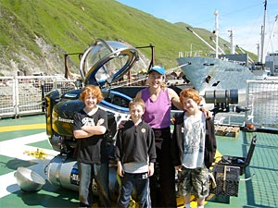
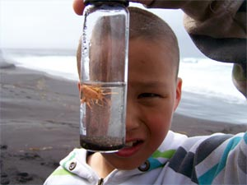
Science & Culture Camps

Slide 30
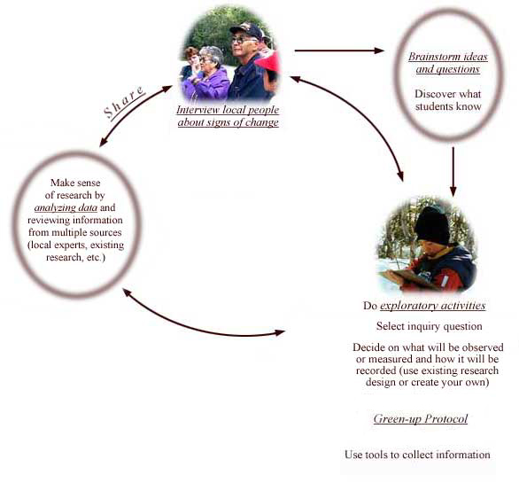
School & Community Monitoring Projects
Interview
local people
Analyze Data
Gather information from multiple sources
Decide What to
Measure or Observe
Date the
Salmon Return
Date of Budburst
Water Temperature
Date of Freeze-up

Slide 31
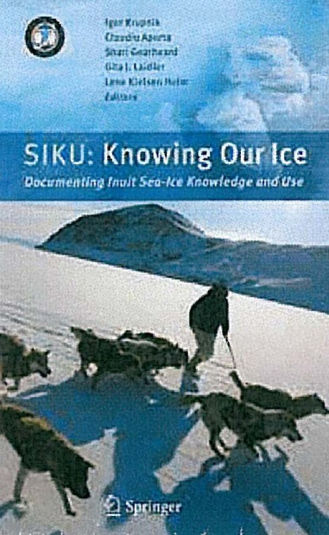
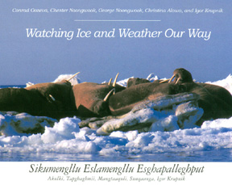
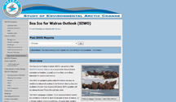
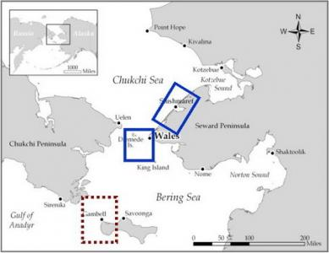
Sea Ice & Weather Monitoring
Sea Ice Outlook for Walrus

Slide 32
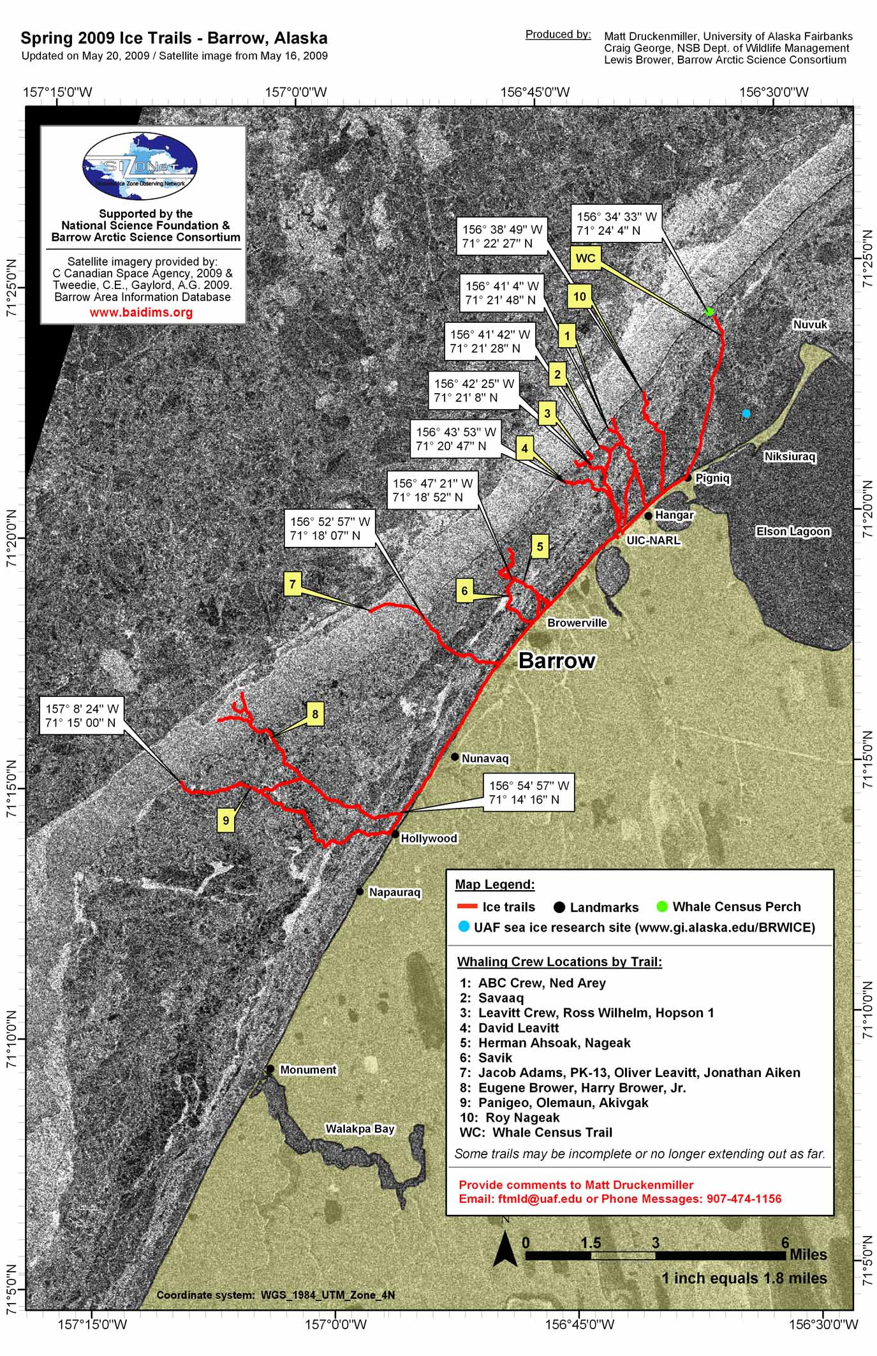
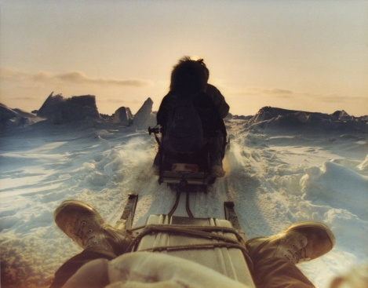
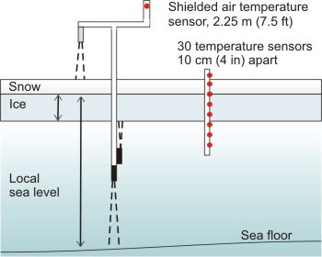
Seasonal Ice Zone Observing Network
Ice Trails
Placement of trails integrates
knowledge about ease of travel,
safety, stability, and persistence
through the season
Mass Balance Equipment
Notes:
Location of ice trails integrates knowledge about ease of travel, safety, stability, and persistence through the season

Slide 33
Teaching Resources at
http://www.coseealaska.net
Join http://oceanseanet.ning.com

Slide 34
Social Networking Site

